Slide 1
Labels 101
What you need to know to sell labels

Slide 2
In This Labels 101 Module
Why sell labels?
Label basics to get you started
How to successfully sell labels
What you can expect from Discount Labels

Slide 3
Why sell labels?
Here are 4 great reasons
to sell labels:
Labels are everywhere!
Labels are a growing market
You can make good margins
selling labels
America’s leading custom
label supplier, Discount Labels
is on your side!

Slide 4
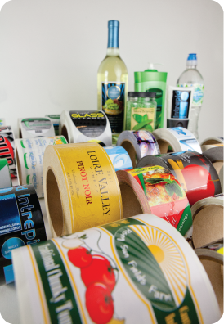
Why sell labels?
And lots of other reasons too!
It’s easy to become a label expert to help your customers
Over 25% of label orders are reorders – no selling involved!
Customers need labels all year long – no seasons or cycles
Discount Labels offers:
  A wide selection of specialty and standard labels
  Very competitive prices
  Easy online ordering, quoting, order status and more
  Super quick turnarounds
  $6.95 flat rate ground shipping for online orders

Slide 5
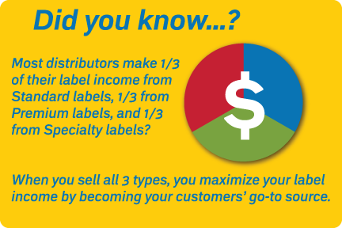
Label Basics to Get You Started
Anatomy of a label
3 basic types of labels
  Standard labels
  Premium labels
  Specialty labels
Ordering labels

Slide 6
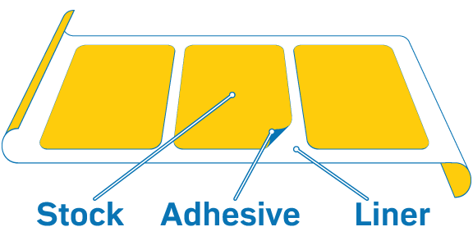
Label Basics: Anatomy of a Label

Slide 7
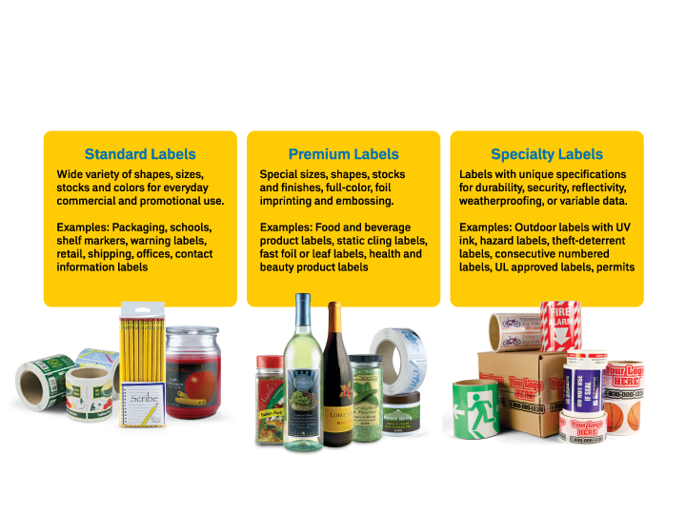
Label Basics: 3 Types of Labels

Slide 8
Label Basics: Ordering Labels
Every label order has a unique
set of specifications such as:
Shape
Size
Stock
Ink colors
Quantity
Finished as rolls or sheets
Special finishing
When you’re ready to order…
Simply be prepared to
answer these 4 questions:
What will the label be applied to?
What will the label be exposed to?
Will you apply the label by hand or machine?
Does the label require special finishing?

Slide 9
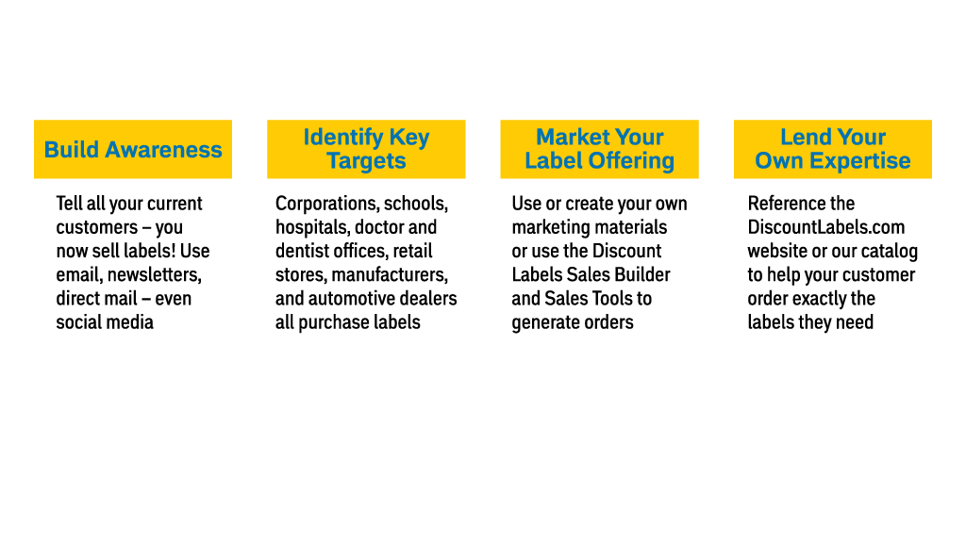
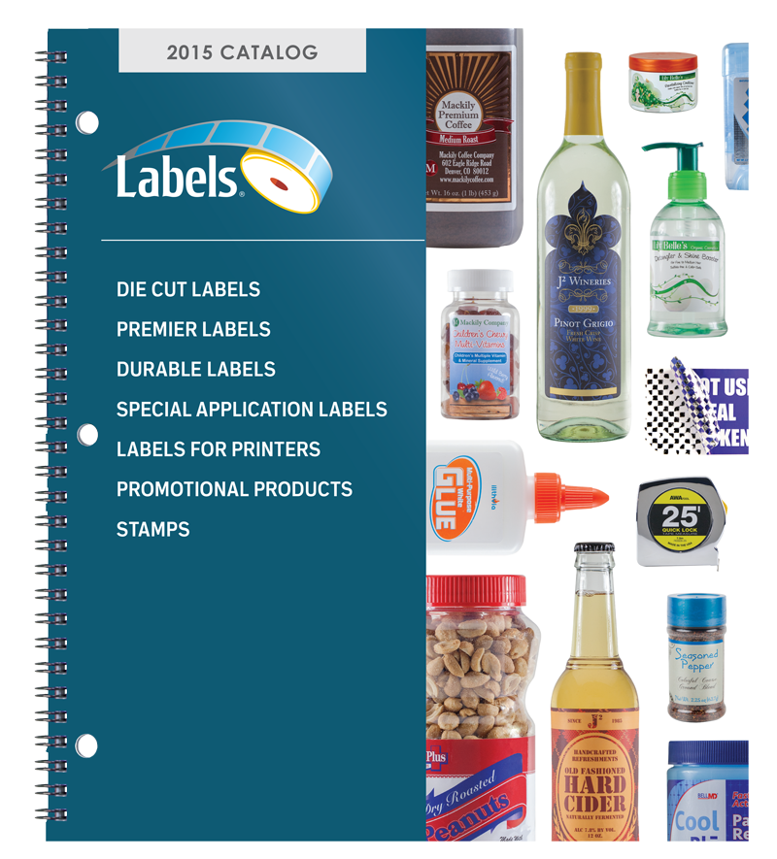
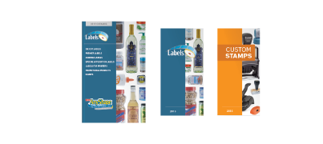
How to Sell Labels to Your Customers
Discount Labels offers FREE Sales Builders to help you build your label business. Our full-size catalog, mini-catalog, and statement stuffers are just a few examples of our Sales Tools.

Slide 10
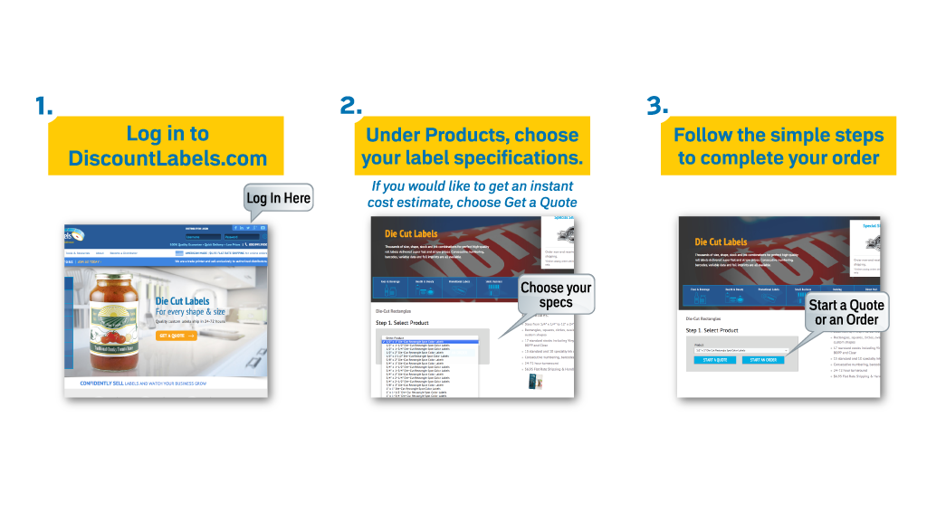
How to Order from Discount Labels in 3 Easy Steps

Slide 11
You are now ready to start making money selling labels!
Labels 101 Summary
  It’s a great time to sell labels! Labels are everywhere and the income potential keeps growing. Every industry, business and organization needs labels.
  Selling labels is easy! With some basic know-how, you can comfortably sell to your customers. Use your own marketing tools or our Sales Builder to get new customers.
  All the information you need to create and place a label order is available at DiscountLabels.com, in the Discount Labels catalog, or by calling one of our label experts at 800.995.9500

Slide 12
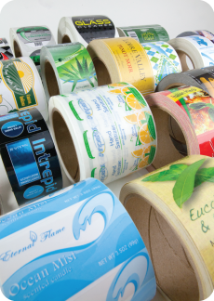

Thank you!
The entire team at Discount Labels looks forward
to working with you on your next label project.
Contact us in the way that works best for you.
DiscountLabels.com
800.995.9500
For cost estimates: quotes@discountlabels.com
To place an order: art@discountlabels.com
For sales builders, catalogs or samples:
marketing@discountlabels.com

